Slide 1
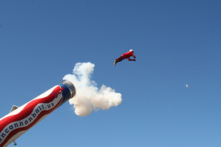
Human Cannonball
By: Hayley, Kerri and Jonny

Slide 2
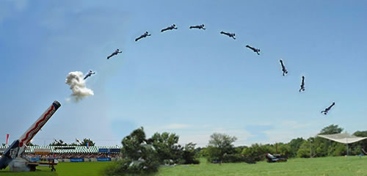
Settings
Cannon Height: 10 meters
Net Height: 10 meters
Height of the hoop: 60 meters
Angle: 45 degrees
Initial Velocity: 15.6526 m/s

Slide 3
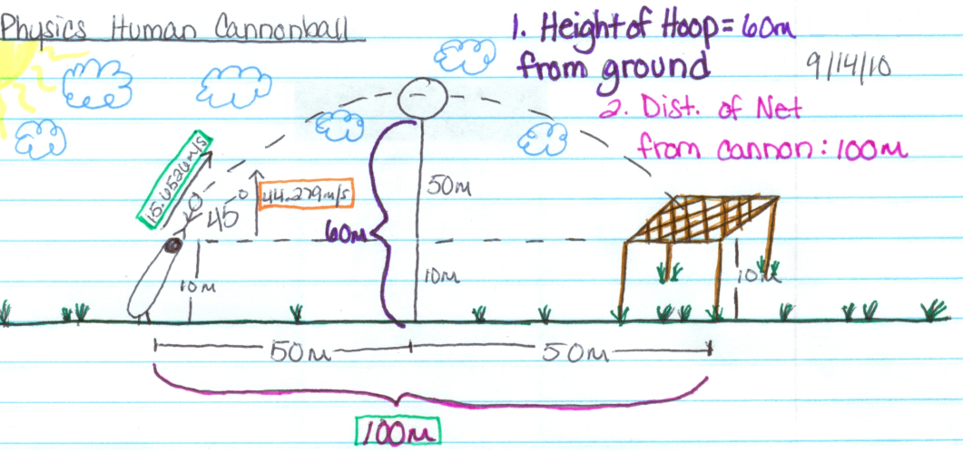
Drawing

Slide 4
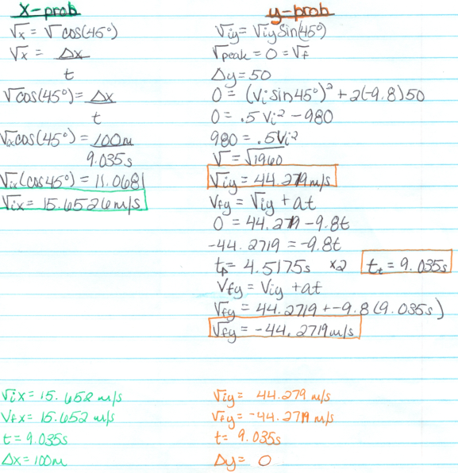
Calculations

Slide 5
PROPOSAL
Dear Clowns,
Per our specifications, the cannon should be launched at an angle 45 degrees above the horizontal. The cannon’s mouth should be 10 meters above the ground and the clown should be launched with a horizontal velocity of 15.652 meters per second.
The net should be placed 100 meters away from the front of the cannon (if you want your clown to land directly on the edge of the net… a little excitement ☺). The net should be 10 meters above ground. The hoop that your clown will be diving through should be 60 meters above the ground. Have fun and good luck with this promotion! If it doesn’t work or someone dies… Mrs. Geddes made all the calculations!

Slide 6
The Story…
Well, it all started on a dark Tuesday afternoon. Hayley, Kerri, and Jonny were smoking smarties out in the back of the school when a bright idea popped into Jonny’s head, he was the smartest of the bunch. He decided that it would be a great idea to make a human cannonball and launch himself over to Creekview and steal their secret recipe for how to be the worst school in the history of the world!!!!!
Jonny would be shot from the cannon at a 45 degree angle and at a speed of 15.652 meters per second. The net will be 10 meters off the ground (slightly higher than the bunch of geniuses that were smoking smarties ;) hahaha). The launch was successful!!!!! Jonny is officially the smartest person to ever walk the face of the Earth.

